Slide 1
Codecademy Capstone Project:
Netflix Stock Profile
January 1, 2018

Slide 2
Overview
In this presentation we will analyze Netflix stock profile
The distribution of the stock prices for the past year
Netflix's earnings and revenue in the last four quarters
The actual vs. estimated earnings per share for the four quarters in 2017
A comparison of the Netflix Stock price vs the Dow Jones Industrial Average price in 2017

Slide 3
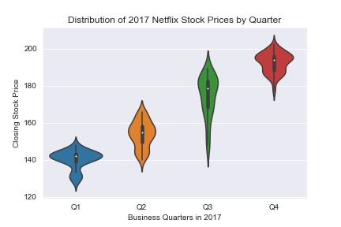
The distribution of the stock prices for the past year
Those violins are looking like a jelly-fish, but also is that stock price is definitely growing each year
I would say, the range is around 140-150 stock price
The highest price was 210~ and the lowest was 120

Slide 4
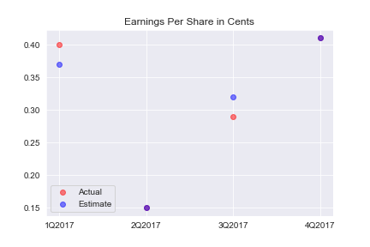
Netflix's earnings and revenue in the last four quarters
Bingo! it means that our estimate earnings and actual earnings was correct and dots were like colided in the graph

Slide 5
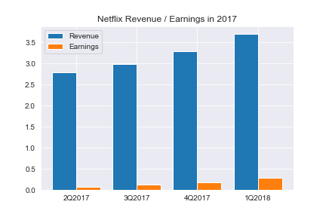
The actual vs. estimated earnings per share for the four quarters in 2017
Revenue follows, we could see a growth for 1 cent for Q1 2018
Earnings definitely follows a trend and increased for .5 cent from almost 0 in Q1 2018
Roughly, its ~5% in average from Q2'17 - Q1'18 with variation Q2 2.35%, Q3 4.35%, Q4 5.64%, Q1 7.84% per quarter

Slide 6
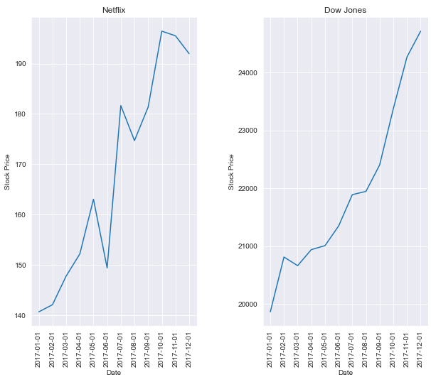
A comparison of the Netflix Stock price vs the Dow Jones Industrial Average price in 2017
In average Netflix performed exactly the same as DJI in 2017, we could see constant growth of the stock price, although some of the small crises affected Netflix more than DJI and we could see some noticeable spikes on 01-06-17, 01-08-17 and 01-11-17/01-12-17, on the other side DJI was flat or showed same growth on those months
As I mentioned before Netflix was more volatile due to few spikes
If I understand it correctly, the prices are differ tremendously, for Netflix its two hundreds of dollars 200~$, but for DJI its twenty thousands 25000~$

Slide 7
Thank you!

